Slide 1
266 Natural Language Processing
Week 4: Pre-Trained Transformers

Slide 2
This Week
Goals
Deepen our understanding of Transformer architectures
Understanding the Idea and Value of Pre-Trained Transformers

Slide 3
Peeking Ahead
Week 1: Introduction
Week 2: Text Classification
Week 3: Language and Context
Week 4: Pretrained Transformers
Week 5: Text Generation Models
Week 6: Machine Translation PROJECT PROPOSAL DUE Feb 18
Week 7: Question Answering & Summarization
Week 8: Linguistic Representation
Week 9: Entities and Linking
Week 10: Embedding-based Retrieval
Week 11: Multimodality in NLP
Week 12: ML Fairness and Privacy
Week 13: NLP in the Real World

Slide 4
Announcements
Reminder: Homework assignments are to be completed individually.
See Syllabus: Collaboration Policy
You may discuss assignment concepts as a group but homework questions should be answered individually
Ed Discussion is an excellent vehicle for discussion
Assignment 2 (Classification) - released this past Friday 01/26
Due Sunday, 02/11 (Tuesday 02/13 if you use late days)
Please come to an office hour if you are having difficulty with it
Assignment 3 (QA) to be released Friday 02/16.
Project Proposals - Due 02/18!
Questions?
Concerns?

Slide 5
Announcements
Paper reading sessions:
oLMpics-On What Language Model Pre-training Captures
Mark: Tuesday 01/30 5:30 pm PST
Solving olympiad geometry without human demonstrations
AlphaCode 2
Peter: Tuesday 02/06 12:00 pm PST
Notebook Walkthroughs:
The mathematics of back propagation
James: Tuesday 02/13 6:30 pm PST
Concerns?

Slide 6
The Plan
Structure of Class
Review of Last Week’s Material
Contextualized Embeddings
Transformers
Self-Attention
Transformer Architectures
Transfer Learning, Pre-training and Fine-Tuning

Slide 7
Key Learnings Review
Pre-Trained Transformers

Slide 8
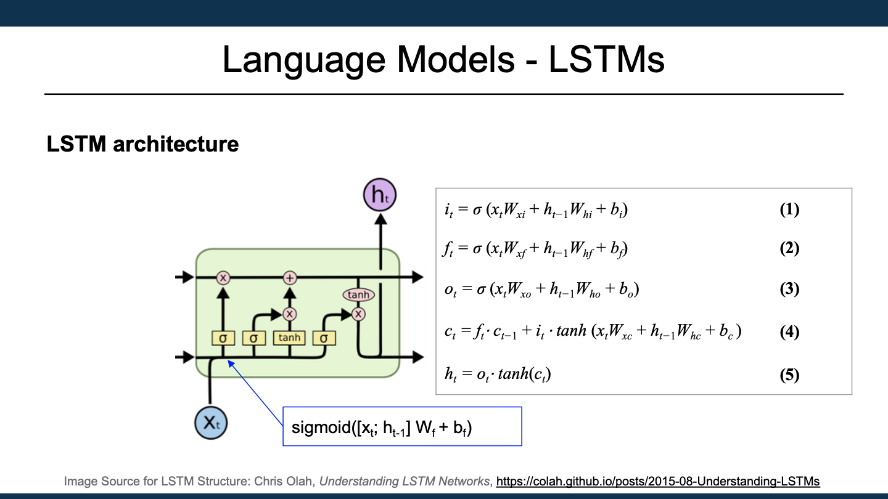
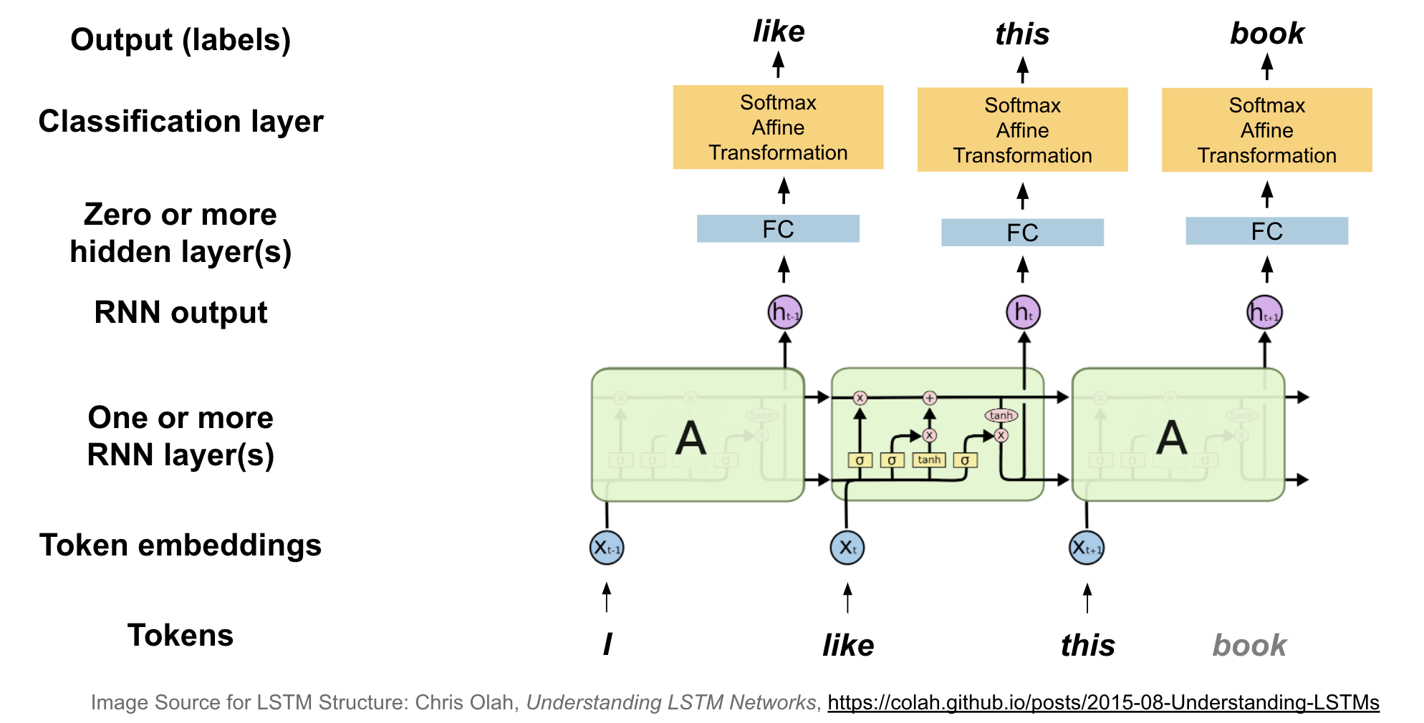
Language Models & LSTMs
Questions:
How do we usually train these models
How is inference done?

Slide 9
Language Models & LSTMs
Questions:
How do we usually train these models
How is inference done?

Slide 10
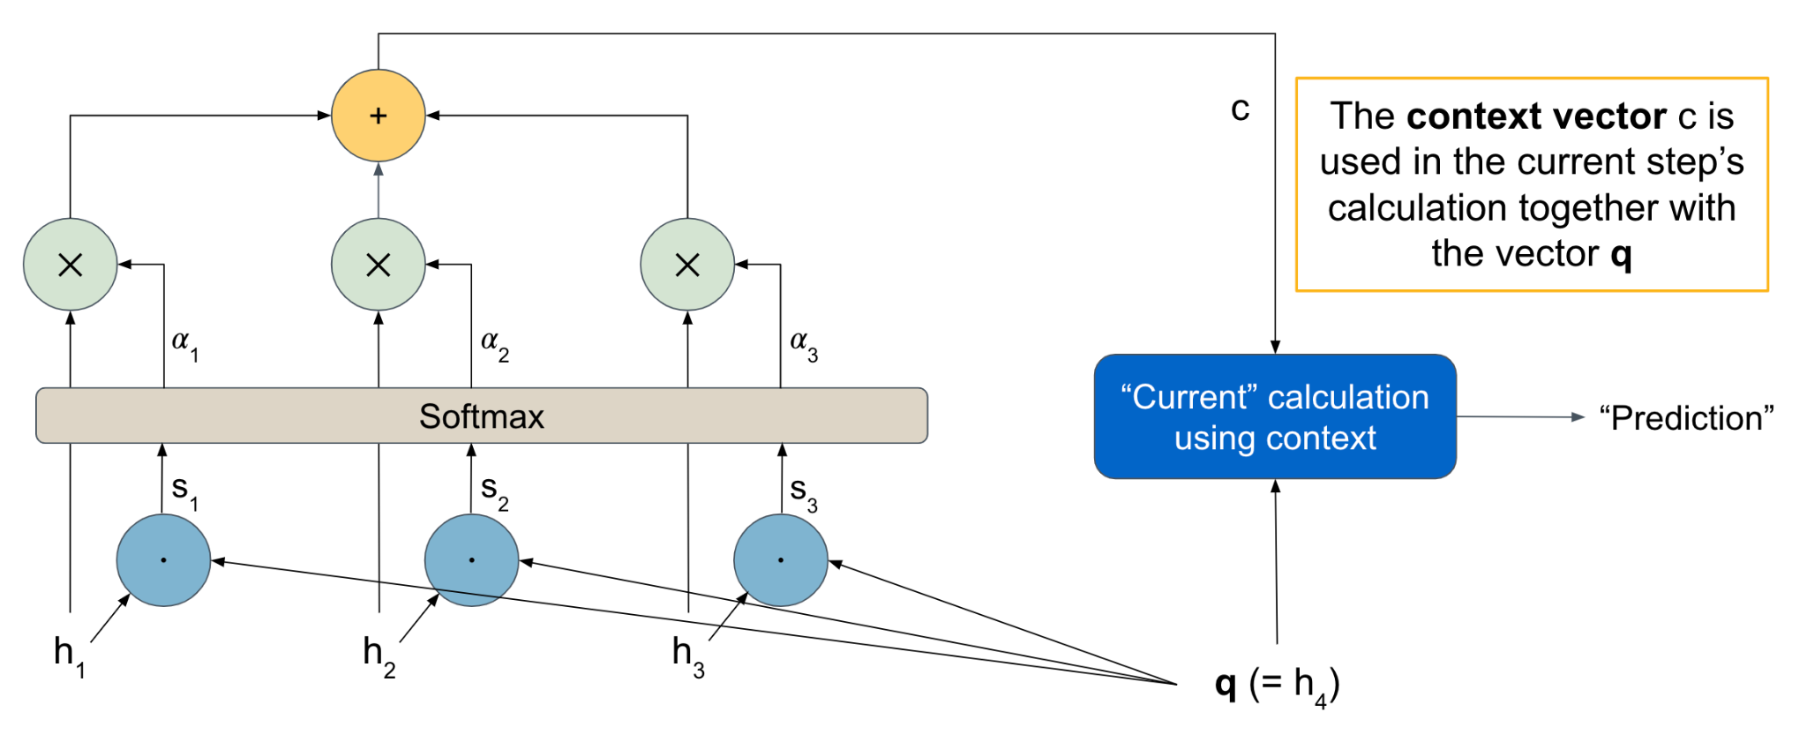
Context & Attention: Dot-Product Attention

Slide 11
Context & Attention: Dot-Product Attention
v₁= h₁
v₂= h₂
v₃= h₃
k₁=
k₂=
k₃=

Slide 12
Simple Attention
Attention layer
Word embeddings (keys/values)
reuse embeds as values
multiply
this
delightful
movie
got
laughs
1
0
0
0
sum
2
-1
.5
-.3
dot product
0
0
1.9
-1.7
0
3
-1
0
softmax
0
0
2
-2
1
0.03
1.4
-1.4
3
0.26
-3
0.00
use embeds as keys
-1
0.00
4
0.70
attention weights (alphas)
query vector
1
-1
Notes:
Pink = input (4 observations)
H1 = blue (4 hidden states but W and b are same size as they get re-used for each observation)
H2 = yellow (4 hidden states but W and b are same size as they get re-used for each observation)
Output = green (4 predictions)

Slide 13
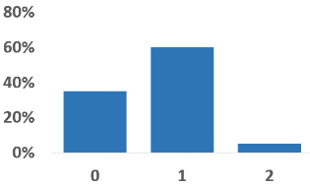
Revisiting Averaging Networks
Output: Probability distribution over class labels
How to do it:
“Learn” a query vector q and use attention calculation, with embedding vectors as keys (and values)!
(see upcoming assignment!)
Sigmoid/Softmax
Affine
Nonlinearity
Averaging word vectors element-wise
(“bag of words”)
Affine
q
k₁
k₂
k…
k_{n}
‘this’
‘is’
...
‘use’
Input:
“this is of great use”

Slide 14
DAN
X₁₁
X₁₂
D
Q
X₂₁
A₁
X₂₂
D
A₂
Q
X₃₁
X₃₂
D
X₄₁
X₄₂
Word embeddings (X)
dense hidden layer (D)
output layer (Q)
averaging layer (A)
this
delightful
movie
got
laughs
W
W
softmax(z)
relu(z)
x
x
q
+
=
=
z
+
z
b
b
Notes:
Pink = input (4 observations)
H1 = blue (4 hidden states but W and b are same size as they get re-used for each observation)
H2 = yellow (4 hidden states but W and b are same size as they get re-used for each observation)
Output = green (4 predictions)

Slide 15
WAN
X₁₁
X₁₂
D
O
X₂₁
A₁
X₂₂
D
A₂
Word embeddings (X)
X₃₁
O
X₃₂
D
Q₁
this
delightful
movie
got
laughs
Attention layer (A)
Q₂
mult
Dense hidden layer (D)
Output layer (O)
W
W
softmax(z)
relu(z)
dot
soft
x
x
Query embedding (Q)
sum
+
=
z
+
=
z
1x →
b
b
Notes:
Pink = input (4 observations)
H1 = blue (4 hidden states but W and b are same size as they get re-used for each observation)
H2 = yellow (4 hidden states but W and b are same size as they get re-used for each observation)
Output = green (4 predictions)

Slide 16
Async Review & Contextualized Embeddings
Pre-Trained Transformers

Slide 17
Goal
What was the idea here?
Static word vectors
Today | the | bank | is | closed
You | can | bank | on | me
You | can | count | on | me
Context-based word vectors
Today | the | bank | is | closed
You | can | bank | on | me
You | can | count | on | me

Slide 18
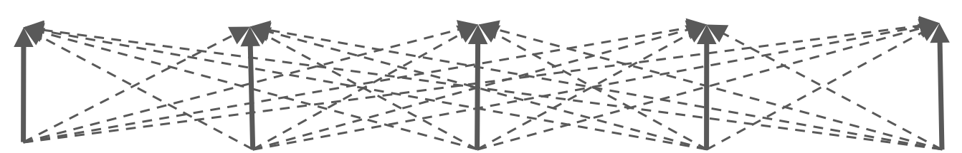
Goal
Different E(‘bank’) for both sentences
Intuition?
↑ | ↑ | ↑ | ↑ | ↑
E₁ | E₂ | E₃ | E₄ | E₅
e₁ | e₂ | e₃ | e₄ | e₅
w₁ | w₂ | w₃ | w₄ | w₅
Today | the | bank | is | closed
The | river | bank | is | steep
Same e(‘bank’) for both sentences

Slide 19
Self-Attention
Pre-Trained Transformers

Slide 20
How Can We Solve the Sequential Issue in RNNs
Attention!!
Why could that be better for computational purposes?
“ ~ ”
x
x
la
maison
bleue
la
maison
bleue

Slide 21
Self Attention
One Self-Attention Head
dot, softmax
alphas for tok1
Word embeddings
query vectors
alphas for tok2
W^{Q}
alphas for tok3
alphas for tok4
this
delightful
movie
got
laughs
x
alphas for tok5
key vectors
x
W^{K}
x
context vect for tok1
value vectors
context vect for tok2
W^{V}
context vect for tok3
context vect for tok4
mult, sum
context vect for tok5
Notes:
Pink = input (4 observations)
H1 = blue (4 hidden states but W and b are same size as they get re-used for each observation)
H2 = yellow (4 hidden states but W and b are same size as they get re-used for each observation)
Output = green (4 predictions)

Slide 22
Self-Attention (1-Layer, 1 Head)
‘This’ ‘house’ ‘is’ ‘now’ ‘blue’
1
-2
2
2
7
Embedding E (from Token + Position)
12
-5
2
1
-1
3
3
-2
-2
12
-1
3
7
-6
3
Sentence
Notes:
Self Attention example (appendix)
Query vector - used to ask the question of the neighbors
Key vectors - answer the incoming question “are you relevant for me”
Value vector - what we send out to be multiplied
Q2 is asking k1,k2,k3,k4,k5 “are you relevant for me”

Slide 23
Self-Attention (1-Layer, 1 Head)
W^{Q} W^{K} W^{V}
Learned weight matrices
‘This’ ‘house’ ‘is’ ‘now’ ‘blue’
0.34
-0.11
-0.13
-0.50
0.05
0.32
Weight Matrices
W^{Q}, W^{K}, W^{V}
-0.12
0.12
-0.11
0.11
0.22
0.09
-0.29
-0.39
0.29
0.45
-0.26
-0.14
0.01
–0.09
-0.07
-0.39
-0.02
0.61
1
-2
2
2
7
Embedding E (from Token + Position)
12
-5
2
1
-1
3
3
-2
-2
12
-1
3
7
-6
3
Sentence
Notes:
Self Attention example (appendix)
Query vector - used to ask the question of the neighbors
Key vectors - answer the incoming question “are you relevant for me”
Value vector - what we send out to be multiplied
Q2 is asking k1,k2,k3,k4,k5 “are you relevant for me”

Slide 24
Self-Attention (1-Layer, 1 Head)
Q₁ K₁ V₁ Q₂ K₂ V₂ Q₃ K₃ V₃ Q₄ K₄ V₄ Q₅ K₅ V₅
W^{Q} W^{K} W^{V}
Learned weight matrices,
multiply each matrix
by each embedding
to get each token’s
Q, K and V vectors
‘This’ ‘house’ ‘is’ ‘now’ ‘blue’
Queries, Keys, Values (E x W^{Q}, E x W^{K}, E x W^{V})
1
-1
3
2
1
-1
4
-2
2
4
-1
2
2
2
-2
1
3
-1
-1
1
-1
1
-4
4
2
1
-4
-5
1
1
0.34
-0.11
-0.13
-0.50
0.05
0.32
Weight Matrices
W^{Q}, W^{K}, W^{V}
-0.12
0.12
-0.11
0.11
0.22
0.09
-0.29
-0.39
0.29
0.45
-0.26
-0.14
0.01
–0.09
-0.07
-0.39
-0.02
0.61
1
-2
2
2
7
Embedding E (from Token + Position)
12
-5
2
1
-1
3
3
-2
-2
12
-1
3
7
-6
3
Sentence
Notes:
Self Attention example (appendix)
Query vector - used to ask the question of the neighbors
Key vectors - answer the incoming question “are you relevant for me”
Value vector - what we send out to be multiplied
Q2 is asking k1,k2,k3,k4,k5 “are you relevant for me”

Slide 25
Self-Attention (1-Layer, 1 Head)
Dot Product Scores s (s = Q_{i} · K_{j} for all i, j)
Q₂ K₁ = -5
Q₂ K₂ = 1
Q₂ K₃ = 0
Q₂ K₄ = -3
Q₂ K₅ = 3
Q₁ K₁ V₁ Q₂ K₂ V₂ Q₃ K₃ V₃ Q₄ K₄ V₄ Q₅ K₅ V₅
‘This’ ‘house’ ‘is’ ‘now’ ‘blue’
Queries, Keys, Values (E x W^{Q}, E x W^{K}, E x W^{V})
1
-1
3
2
1
-1
4
-2
2
4
-1
2
2
2
-2
1
3
-1
-1
1
-1
1
-4
4
2
1
-4
-5
1
1
1
-2
2
2
7
Embedding E (from Token + Position)
12
-5
2
1
-1
3
3
-2
-2
12
-1
3
7
-6
3
Sentence
Notes:
Self Attention example (appendix)
Query vector - used to ask the question of the neighbors
Key vectors - answer the incoming question “are you relevant for me”
Value vector - what we send out to be multiplied
Q2 is asking k1,k2,k3,k4,k5 “are you relevant for me”

Slide 26
Self-Attention (1-Layer, 1 Head)
Attention Weights (α = softmax(s)) (α₂ shown here)
0.0003 0.114 0.042 0.0021 0.842
Dot Product Scores s (s = Q_{i} · K_{j} for all i, j) (only j=2 shown here)
Q₂ K₁ = -5
Q₂ K₂ = 1
Q₂ K₃ = 0
Q₂ K₄ = -3
Q₂ K₅ = 3
Q₁ K₁ V₁ Q₂ K₂ V₂ Q₃ K₃ V₃ Q₄ K₄ V₄ Q₅ K₅ V₅
‘This’ ‘house’ ‘is’ ‘now’ ‘blue’
Queries, Keys, Values (E x W^{Q}, E x W^{K}, E x W^{V})
1
-1
3
2
1
-1
4
-2
2
4
-1
2
2
2
-2
1
3
-1
-1
1
-1
1
-4
4
2
1
-4
-5
1
1
1
-2
2
2
7
Embedding E (from Token + Position)
12
-5
2
1
-1
3
3
-2
-2
12
-1
3
7
-6
3
Sentence
Notes:
Self Attention example (appendix)
Query vector - used to ask the question of the neighbors
Key vectors - answer the incoming question “are you relevant for me”
Value vector - what we send out to be multiplied
Q2 is asking k1,k2,k3,k4,k5 “are you relevant for me”

Slide 27
Self-Attention (1-Layer, 1 Head)
Weighted value vectors
(a x V)
-0.0
-0.1
0.1
0.0
-1.7
-0.0
-0.1
0.2
-0.0
0.8
0.0003 0.114 0.042 0.0021 0.842
x x x x x
Attention Weights (α = softmax(Q · K))
Q₁ K₁ V₁ Q₂ K₂ V₂ Q₃ K₃ V₃ Q₄ K₄ V₄ Q₅ K₅ V₅
‘This’ ‘house’ ‘is’ ‘now’ ‘blue’
Queries, Keys, Values (E x W^{Q}, E x W^{K}, E x W^{V})
1
-1
3
2
1
-1
4
-2
2
4
-1
2
2
2
-2
1
3
-1
-1
1
-1
1
-4
4
2
1
-4
-5
1
1
1
-2
2
2
7
Embedding E (from Token + Position)
12
-5
2
1
-1
3
3
-2
-2
12
-1
3
7
-6
3
Sentence
Notes:
Self Attention example (appendix)
Query vector - used to ask the question of the neighbors
Key vectors - answer the incoming question “are you relevant for me”
Value vector - what we send out to be multiplied
Q2 is asking k1,k2,k3,k4,k5 “are you relevant for me”

Slide 28
Self-Attention (1-Layer, 1 Head)
Context vector
sum(a x V)
(context vector for tok2 shown here)
+
-1.7
0.9
0.0003 0.114 0.042 0.0021 0.842
x x x x x
Attention Weights (α = softmax(Q · K))
Q₁ K₁ V₁ Q₂ K₂ V₂ Q₃ K₃ V₃ Q₄ K₄ V₄ Q₅ K₅ V₅
‘This’ ‘house’ ‘is’ ‘now’ ‘blue’
Queries, Keys, Values (E x W^{Q}, E x W^{K}, E x W^{V})
1
-1
3
2
1
-1
4
-2
2
4
-1
2
2
2
-2
1
3
-1
-1
1
-1
1
-4
4
2
1
-4
-5
1
1
1
-2
2
2
7
Embedding E (from Token + Position)
12
-5
2
1
-1
3
3
-2
-2
12
-1
3
7
-6
3
Sentence
Notes:
Self Attention example (appendix)
Query vector - used to ask the question of the neighbors
Key vectors - answer the incoming question “are you relevant for me”
Value vector - what we send out to be multiplied
Q2 is asking k1,k2,k3,k4,k5 “are you relevant for me”

Slide 29
Multi-Head Self Attention (1-Layer)
Final context
(concatenate)
-1.7
Head 1
Head 2
Context vectors
(pairwise dot product
scores s = Q · K,
alphas α = softmax(s),
context vector c = sum(α x V))
0.9
1.1
-1.7
1.1
-2.3
0.9
-2.3
W^{Q} W^{K} W^{V} Q₁ K₁ V₁ Q₂ K₂ V₂ …
W^{Q} W^{K} W^{V} Q₁ K₁ V₁ Q₂ K₂ V₂ …
0.34
-0.11
2
0.34
-0.11
2
Queries, Keys, Values (Q = E x W^{Q}, K = E x W^{K},
V = E x W^{V})
-0.13
-0.50
1
-0.13
-0.50
1
0.05
0.32
3
-1
0.10
0.52
4
-2
-0.12
0.12
-0.12
0.12
-0.11
0.11
-1
-0.11
0.11
-1
0.22
0.09
-1
1
-0.01
-0.23
1
-0.29
-0.39
-1
-0.29
-0.39
3
2
0.29
0.45
0.29
0.45
-0.26
-0.14
0.46
0.42
0.01
–0.09
0.01
–0.09
-0.07
-0.39
-0.07
-0.39
-0.02
0.61
-0.20
0.23
Embedding E (from Token + Position)
1
-2
2
2
7
12
-5
2
1
-1
3
3
-2
-2
12
-1
3
7
-6
3
Sentence
‘This’ ‘house’ ‘is’ ‘now’ ‘blue’
Notes:
Self Attention example (appendix)
Query vector - used to ask the question of the neighbors
Key vectors - answer the incoming question “are you relevant for me”
Value vector - what we send out to be multiplied
Q2 is asking k1,k2,k3,k4,k5 “are you relevant for me”

Slide 30
Transformer Architectures
Pre-Trained Transformers

Slide 31

The Transformer Architecture
Image Source:http://jalammar.github.io/illustrated-transformer/

Slide 32
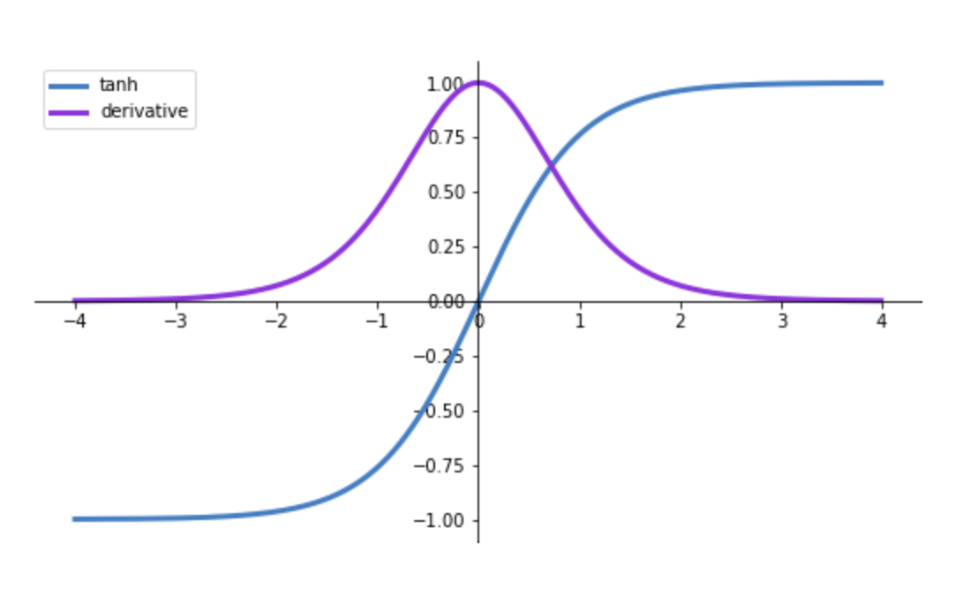
Normalization? What & Why?
x
Questions:
What can go wrong here?
x
Source: Weights & Biases Blog

Slide 33
Transformer
X₁₁
X₁₂
A₁₁
A₁₂
N₁₁
N₁₂
D₁₁
D₁₂
N₁₁
N₁₂
X₂₁
X₂₂
A₂₁
A₂₂
N₂₁
N₂₂
D₂₁
D₂₂
N₂₁
N₂₂
Self attention (A)
X₃₁
A₃₁
N₃₁
D₃₁
N₃₁
X₃₂
A₃₂
N₃₂
D₃₂
N₃₂
q
dot, softmax
W^{Q}
Repeat … (Next transformer block)
Word embeddings
alphas
k
Dense layer (D)
W^{K}
W
relu(z)
v
x
W^{V}
mult, sum
+
=
z
b
Add, Norm (N)
Add, Norm (N)
Notes:
Pink = input (4 observations)
H1 = blue (4 hidden states but W and b are same size as they get re-used for each observation)
H2 = yellow (4 hidden states but W and b are same size as they get re-used for each observation)
Output = green (4 predictions)

Slide 34
BERT (Encoder)
Output
T₁
T₂
T₃
…
T_{n}
Transform
Transform
Transform
…
Transform
N Transformer layers (iteratively improving representation)
Transform
Transform
Transform
…
Transform
Transform
Transform
Transform
…
Transform
Embeddings
(Token + Segment + Position)
E₁
E₂
E₃
…
E_{n}
Replicated from: Devlin et al., BERT: Pre-training of Deep Bidirectional Transformers for Language Understanding, https://arxiv.org/pdf/1810.04805.pdf

Slide 35
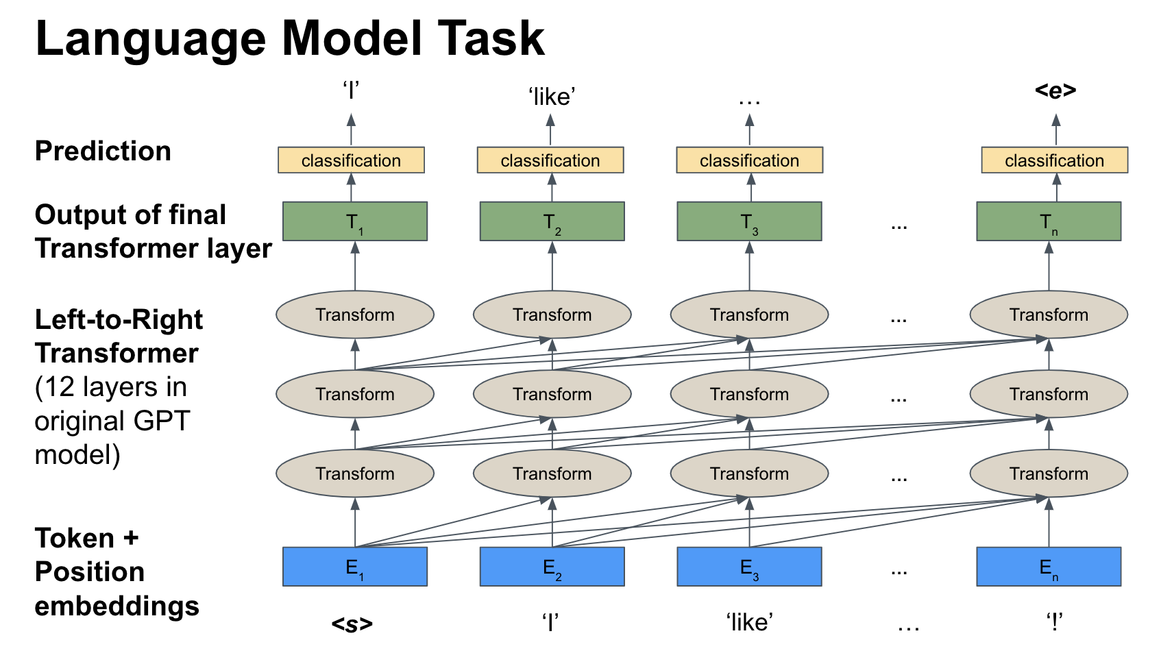
GPT (Decoder)
Questions:
Why can’t we go the ‘other way’?
Notes:
The fat cat sat on the fence and meowed.
The fat cat sat on the → fence
The fat cat sat on the fence → and
The fat cat sat on the fence and → meowed

Slide 36
Transfer Learning
Pre-Trained Transformers

Slide 37
Transfer Learning
Problem: “Can we create one generalized model for all NLP tasks?”
Multi-task Learning: train on multiple tasks and share weights so performance on each task improves Natural Language Processing (almost) from Scratch (Collobert et al., 2011)
Transfer Learning: train a model on a general task that will help on multiple linguistic problems then fine tune that model for your specific problem ELMO,BERT
One (few) Shot: model performs a task after only seeing it once (few times) (GPT-3)
Zero Shot: model performs a task it has never seen which implies good model generalization.

Slide 38
Pre-Training and Fine-Tuning
Pre-training
Learn one or more tasks that provide a foundation for performing other tasks
Predict next word
Predict missing word(s)
Are sentences connected?
Fine-tuning
Add a layer(s) on top that performs your specific task like classification or span identification.
Use your small domain specific training set to train your model to make accurate predictions

Slide 39
From Architecture to Pre-Trained Models
The architecture is powerful… but how can we train it??
What do we need to specify beyond the architecture?

Slide 40
From Architecture to Pre-Trained Models
The architecture is powerful… but how can we train it??
What do we need to specify beyond the architecture?
Datasets
Training Task(s)
Discussion:
How is this done for BERT?
How is this done for GPT? (next week)

Slide 41
BERT
What are the components of the embeddings at the bottom layer?

Slide 42
BERT
What are the components of the embeddings at the bottom layer?
Token embeddings
Position embeddings
Type embeddings
What are the inputs to BERT?
Questions:
What are the dimensions of the corresponding embedding matrices?

Slide 43
BERT
What are the components of the embeddings at the bottom layer?
Token embeddings
Position embeddings
Type embeddings
What are the inputs to BERT?
Input ids
Token type ids
Mask ids
What are some special tokens?
Questions:
What are the dimensions of the corresponding embedding matrices?

Slide 44
BERT
What are the components of the embeddings at the bottom layer?
Token embeddings
Position embeddings
Type embeddings
What are the inputs to BERT?
Input ids
Token type ids
Mask ids
What are some special tokens?
[CLS]
[SEP]
[MASK]
[PAD]
Questions:
What are the dimensions of the corresponding embedding matrices?

Slide 45
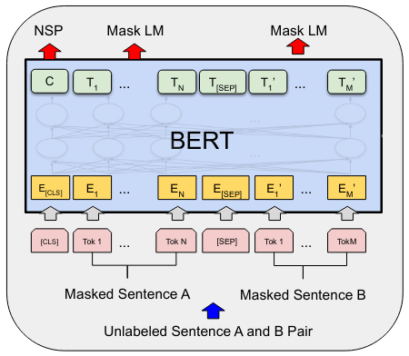
BERT Pre-Training
Questions:
What are the prediction tasks?
Source: Devlin et al., BERT: Pre-training of Deep Bidirectional Transformers for Language Understanding, https://arxiv.org/pdf/1810.04805.pdf
Notes:
Y = The fat cat sat on the fence and meowed
X = The __ cat sat on ___ fence and meowed

Slide 46
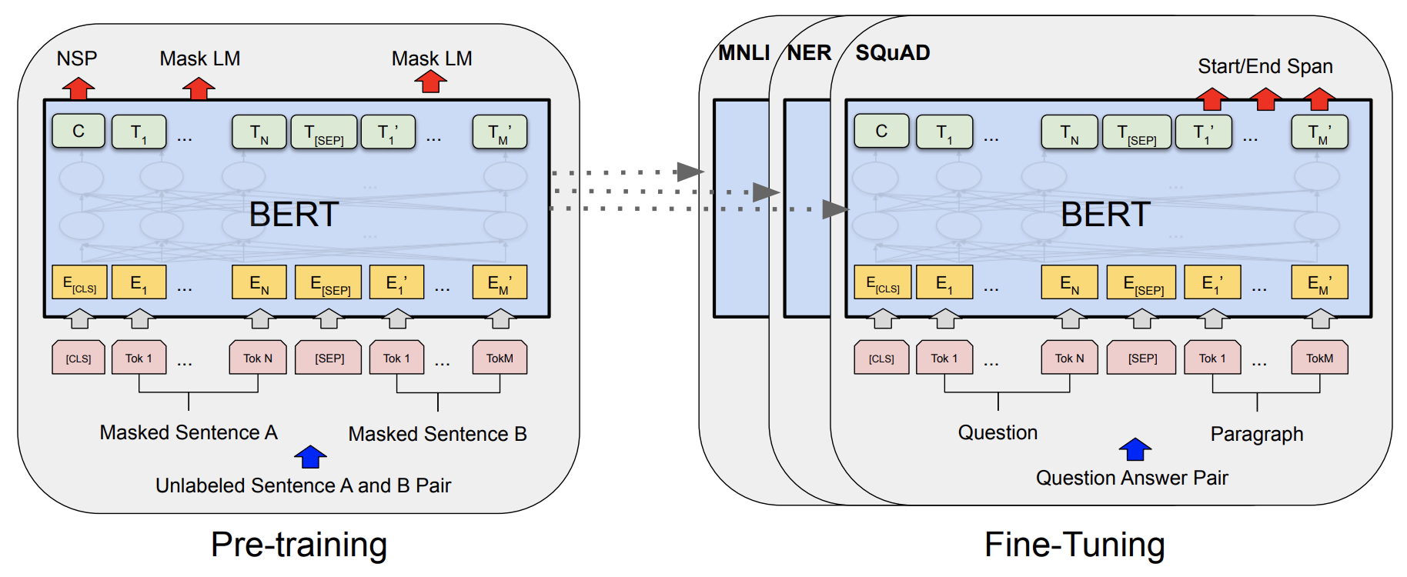
BERT & Downstream Tasks
Source: Devlin et al., BERT: Pre-training of Deep Bidirectional Transformers for Language Understanding, https://arxiv.org/pdf/1810.04805.pdf

Slide 47
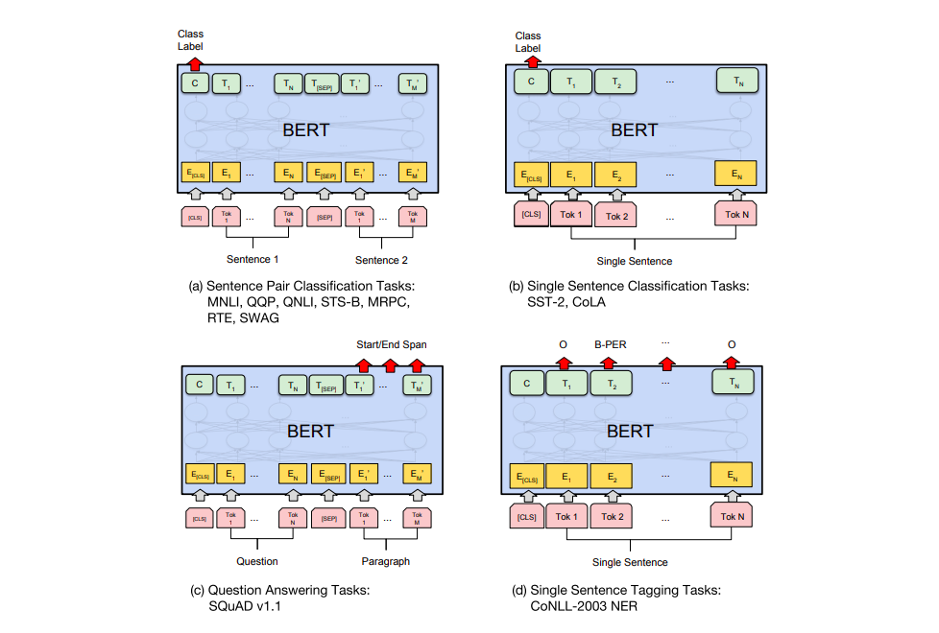
BERT Tasks
Image Source: jalammer.github.io/illustrated-bert

Slide 48
Notebook Walkthrough
Pre-Trained Transformers
Notes:
https://colab.research.google.com/github/datasci-w266/2023-fall-main/blob/master/materials/lesson_notebooks/lesson_4_BERT.ipynb

Slide 49
Paper Peeks/Recent Advances/Challenges
Pre-Trained Transformers

Slide 50
Some Papers (and Resources)
Do we really understand what is happening inside BERT?
A Primer in BERTology: What We Know About How BERT Works
Excellent survey paper
BERT Rediscovers the Classical NLP Pipeline
Interesting use of probes to peer inside black box
Hugging Face BERTology page
Some code resources and other papers

Slide 51
Extras
Pre-Trained Transformers

Slide 52
Simple Attention Calculation
Here’s another look at the basic attention calculation, using a sequence of embedding as keys, and a single query vector separate from the keys

Slide 53
Simple Sample Attention Calculation (Dot Product)
1
“Query” h_{t-1}^{(D)}
.5

Slide 54
Simple Sample Attention Calculation (Dot Product)
1
“Query” h_{t-1}^{(D)}
Compare to all Embeddings h_{i}^{(E)} (“Keys”)
.5
1
1
-1
2

Slide 55
Simple Sample Attention Calculation (Dot Product)
1
“Query” h_{t-1}^{(D)}
Compare to all Embeddings h_{i}^{(E)} (“Keys”)
.5
1
1
-1
2
Score: 0.5 2

Slide 56
Simple Sample Attention Calculation (Dot Product)
1
“Query” h_{t-1}^{(D)}
Compare to all Embeddings h_{i}^{(E)} (“Keys”)
.5
1
1
-1
2
Score: 0.5 2
Softmax: 0.18 0.82

Slide 57
Simple Sample Attention Calculation (Dot Product)
1
“Query” h_{t-1}^{(D)}
Compare to all Embeddings h_{i}^{(E)} (“Keys”)
.5
1
1
-1
2
Score: 0.5 2
For use as context in classification P(y_{t})...
Softmax: 0.18 0.82
1
1
1
Attention Vector:
weighted sum of 0.18 + 0.82 =
the Values
(which are also Keys here)
-1
2
1.46

Slide 58
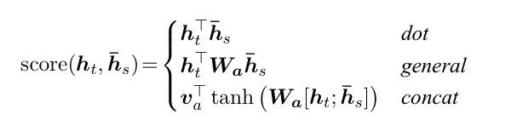
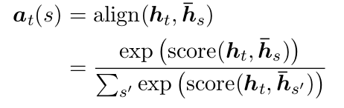
Alternative Attention Score Calculations
Luong et. al experiment with multiple scoring functions, some with a W matrix
This attention framework is probably the most common one and is very close to what is used in Transformer architectures.
This attention framework is very similar to the one used in Bahdanau et. al and a number of other papers.

Slide 59
Another Look at Self-Attention
This is another set of slides that shows the same self-attention process. There are a lot of components, so different ways of visualizing them might be more clear to different students. These images come from The Illustrated Transformer, which is a useful resource.

Slide 60
Critical Component: Self-Attention with Queries, Keys, & Values
What are their roles?
Queries
Keys
Values
Exer (assume dot-product attention)
Q = [[1, 1], [1, -1]]
K = [[1, 0], [2, -1]]
V = [[1, 2], [1, 3]]
→ What is the result for q₁ (manually)?
→ What is the result for both queries (Keras)?
Questions:
Can this be largely parallelized? What can, what cannot?
How is the attention calculation done for Transformers (normalization)?

Slide 61
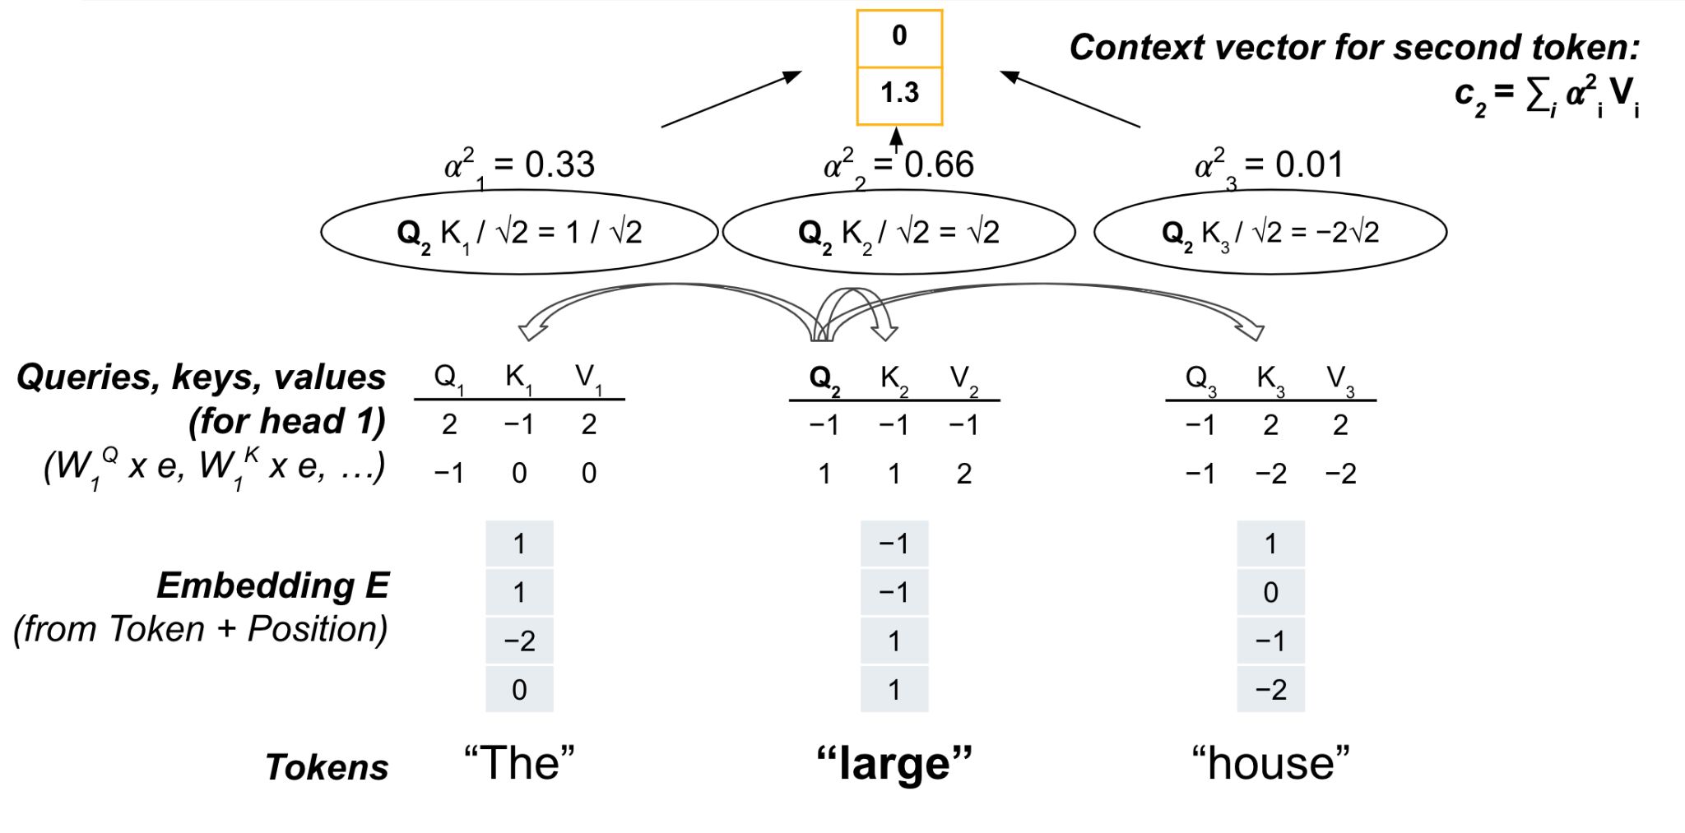
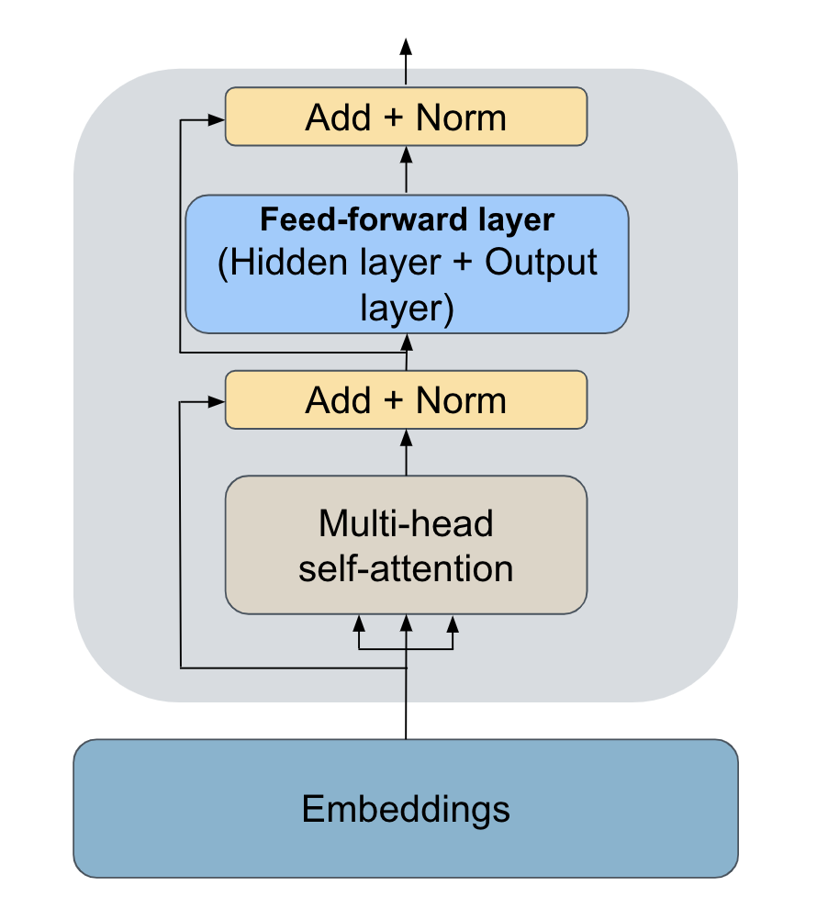
Critical Component: Self-Attention with Queries, Keys, & Values
Questions:
Where are the Q, K, V coming from?
Why/how do the dimensions ‘change’ from Embeddings to Q,K, V?
Comment:
There is more than just self-attention!

Slide 62

Self-Attention (Another example)
Image Source:http://jalammar.github.io/illustrated-transformer/

Slide 63
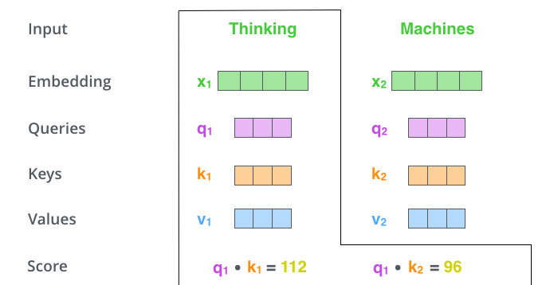
Self-Attention (Another example)

Slide 64
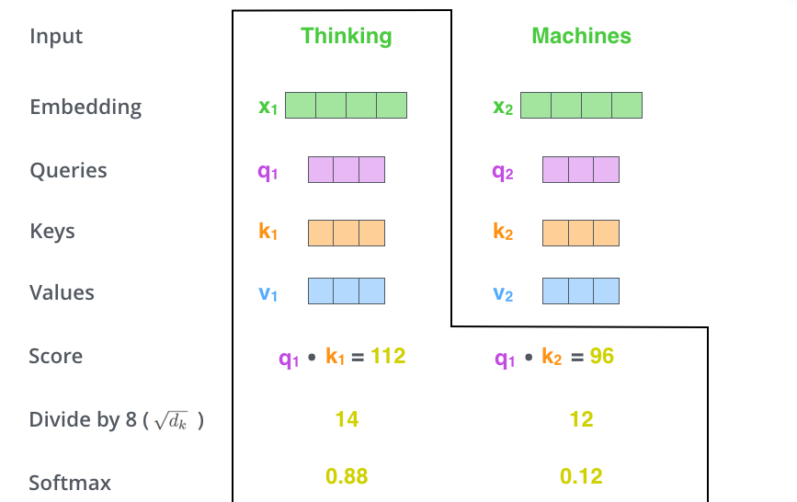
Self-Attention (Another example)

Slide 65

Self-Attention (Another example)

Slide 66

Multi-Head Attention
Image Source:http://jalammar.github.io/illustrated-transformer/

Slide 67

Multi-Head Attention
Image Source:http://jalammar.github.io/illustrated-transformer/

Slide 68
Multi-Head Attention
Image Source:http://jalammar.github.io/illustrated-transformer/

Slide 69
Full Transformer Architecture
These slides break down the full architecture of the original transformer model from the paper “Attention Is All You Need”. It was an encoder-decoder model used for machine translation.
The simplest transformers we talked about this week only use one half of the encoder-decoder setup (BERT is just an encoder, GPT is just a decoder). We’ll talk more next week about encoder-decoder models.

Slide 70
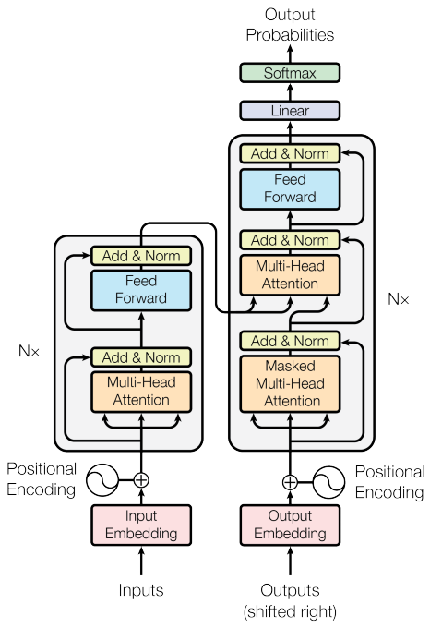

Attention is all you need
NeuroIPS 2017 Vaswani, et al introduced the transformer architecture using Multi-Head Attention

Slide 71

The Transformer Architecture
Image Source:http://jalammar.github.io/illustrated-transformer/

Slide 72

The Transformer Architecture
Image Source:http://jalammar.github.io/illustrated-transformer/

Slide 73

The Transformer Architecture
Image Source: jalammer.github.io/illustrated-bert

Slide 74

Attention with Decoders
Image Source: jalammer.github.io/illustrated-bert

Slide 75

Full Transformer
Image Source:http://jalammar.github.io/illustrated-transformer/

Slide 76

Full Transformer
Image Source:http://jalammar.github.io/illustrated-transformer/

Slide 77
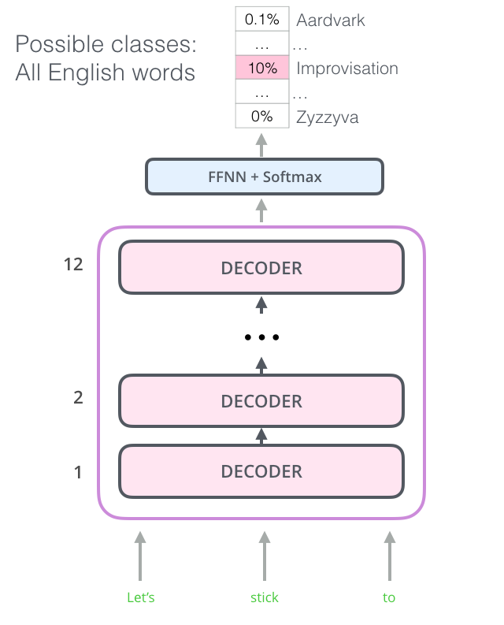
Open AI’s GPT-X
GPT-X uses the decoder side
12 stacked decoders with masked “next words” and using MHA self-attention
Image Source: jalammer.github.io/illustrated-bert

Slide 78
Open AI’s GPT-1
Image Source: jalammer.github.io/illustrated-bert

Slide 79
Open AI’s GPT-1
Image Source: jalammer.github.io/illustrated-bert

Slide 80
Open AI’s GPT-1
Image Source: jalammer.github.io/illustrated-bert

Slide 81
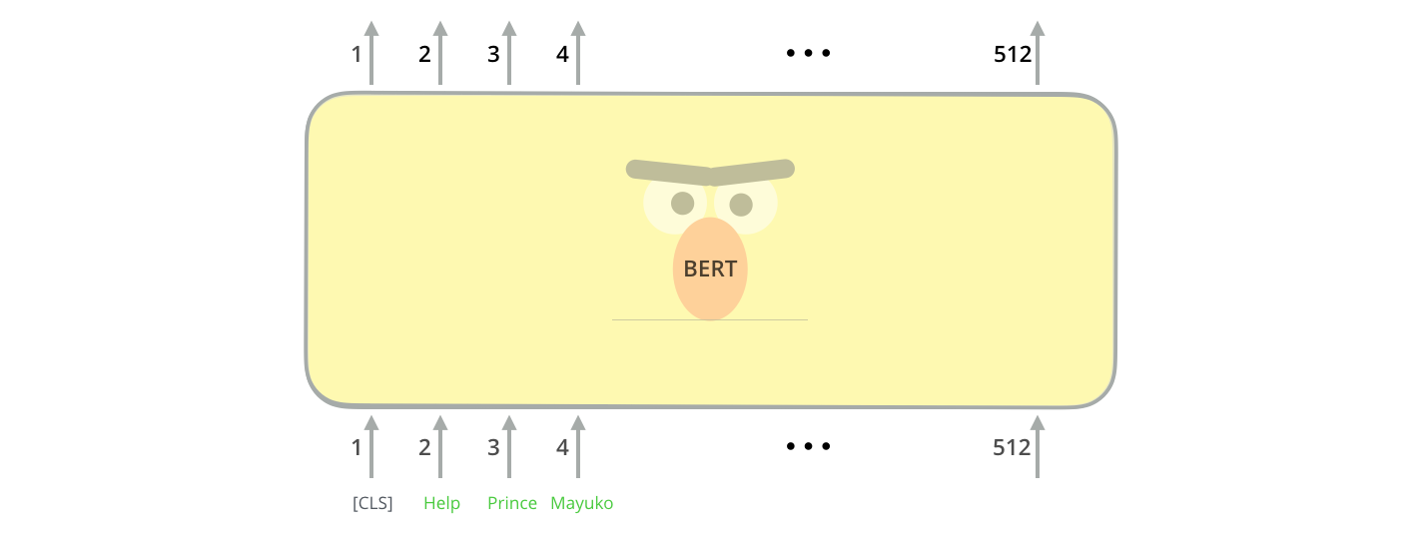
BERT vs GPT-1
Instead of masking the “next word” BERT masks words randomly (12%) in the sentence.
Image Source: jalammer.github.io/illustrated-bert

Slide 82
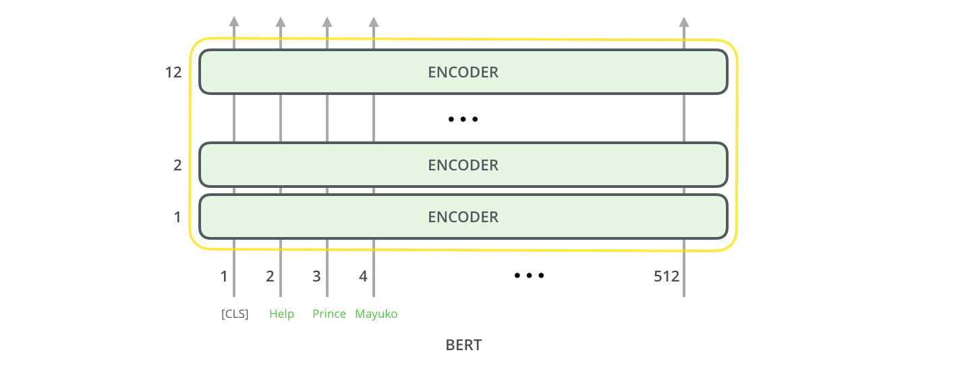
BERT vs GPT-1
Everything can run on the Encoder side of the transformer architecture.
Image Source: jalammer.github.io/illustrated-bert

Slide 83
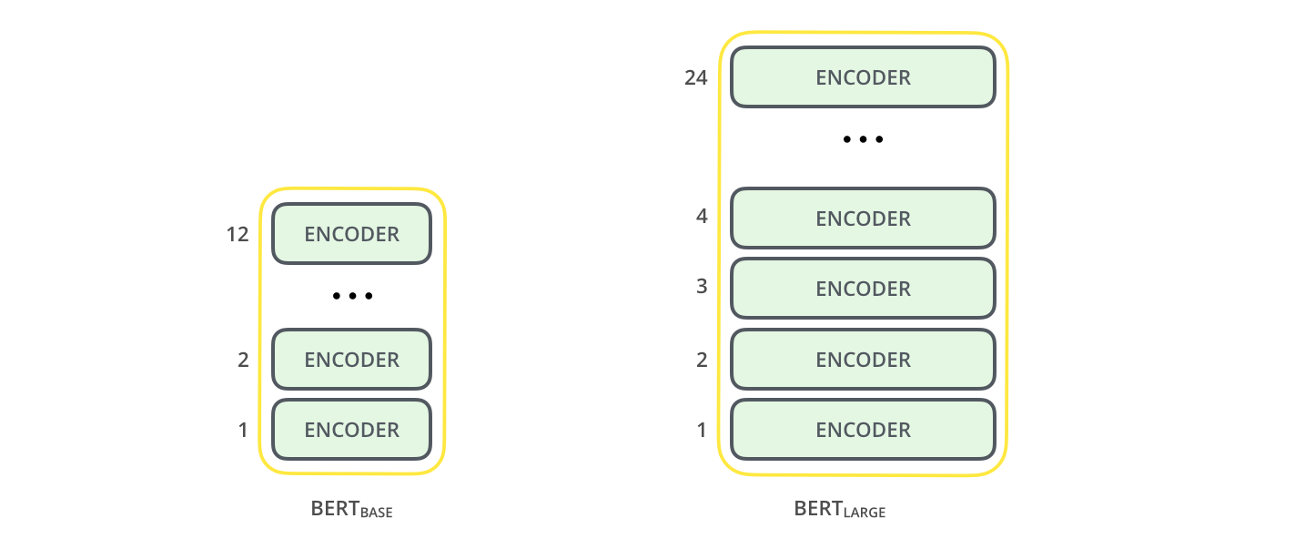
BERT and BIG BERT
BERT_{BASE}: 760 units and 12 encoders (compete with GPT-1)
BERT_{BIG}: 1024 units and 24 encoders
Image Source: jalammer.github.io/illustrated-bert

Slide 84
More Resources on Transformers
An Intuitive Explanation of Self-Attention (clearly written, step-by-step explanation)
Basics of Self-Attention (similar explanations with more visuals)
Intro to Self-Attention in Transformers (a little less clearly written, but better visualizations)
Attention Layers (detailed explanation with more math and code)

Slide 85
Transfer Learning
More historical details on transfer learning and how it relates to similar concepts.

Slide 86
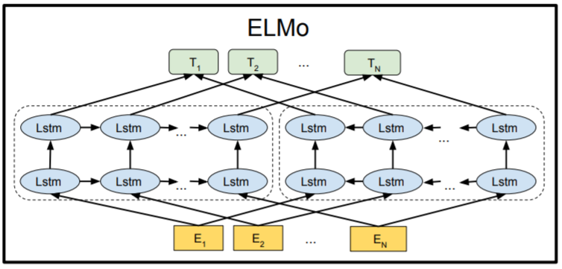
A “Historical” Note: Context-Based Embeddings with ELMo
Paper with deep insight: ”Deep contextualized word representations”, Peters et al, https://arxiv.org/pdf/1802.05365.pdf
Word vectors with context!
Bi-directional LSTM architecture, trained on 1bn+ word corpus on LM task
Final forward/backward vectors are concatenated
Model also returns output for intermediate layers
Image Source: ”BERT: Pre-training of Deep Bidirectional Transformers for Language Understanding”, Devlin et al, https://arxiv.org/pdf/1810.04805.pdf
Notes:
Talk through the architecture. Details of initial word-embeddings from running a CNN over character-level embeddings not crucial here.

